Slide 1
mjam
Delivery Service for food
Case Study By Swapnil Shimpi
Date : 7-Nov-2021

Slide 2
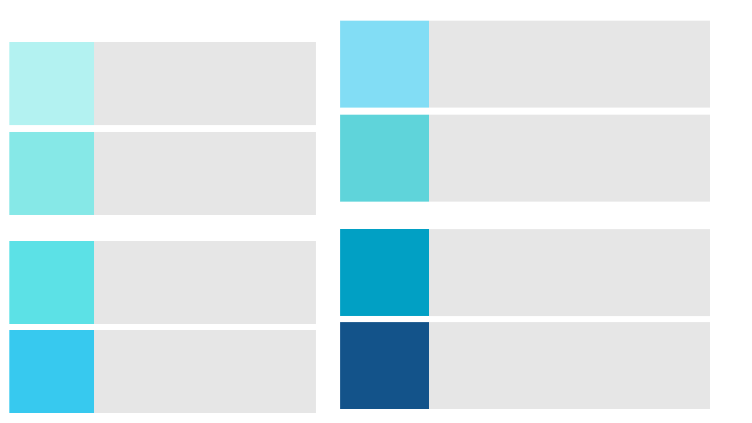

Business Model
Users Restaurants
- Based on age group - Which do not have delivery guys
- Single/Couple/Family - Which do not have website/app
- Heath conscious - Who wants to start new restaurant
- Orders frequently
- Don’t have a time to cook
- Restaurants (veg/Nov-veg/Buffet)
- Fast Food chains
- Coffee house
- Ice cream Parlors
- Vehicle rental service
- Social media influencers
Key
Partners
Customers
Channels
&
Customer
Relationship
- Website and app Development and infra management
- Order fulfillment & shipping
- Scheduled delivery or an instant delivery
- Managing Delivery persons and payouts
- Customer relationship management
- Marketing and Advertisement
- android
- iOS
- desktop_web/mobile_web
- Social Media(Instagram,Facebook etc)
- 24*7 Support
- Payment methods
Key
Activities
Customers
- Easy to browse, order , track and Fast delivery
- 24*7 service ,better pricing ,good offers
- Variety of food options and payment options
Delivery Persons
- Flexible time slots , Good payment and tips from customers
- Technology platform
- Infra structure
- Partnerships
- Sponsors
- Delivery persons
Resources
Value
Proposition
- Infra, Technology setup and managing
- Salaries to employees and Delivery persons
- Marketing and Advertisement
- Commission from each order
- Subscription programs
- Restaurant Listings and Advertising
- Business consultancy services
- Retain existing customers
Cost
Management
Revenue
Streams

Slide 3
Premium Subscription plan
(Prices mentioned are just an assumptions)
 | Gold Membership | Meal Box Membership
Target Customer | All Food lovers | Customers placing daily order for a lunch or dinner (Usually Students ,seniors ,Living alone, Can’t cook due to busy schedule)
Subscription charges | Plan1 - 1 Months plan at 10$ Plan2- 3 months plan at 9$ Plan3- 12 Months plan at 100$ ( 2 months free) - Early Bird offer ( If Subscribed in next one week then additional 5% off on subscription amount ) | Plan1- 1 Month plan at 8$ Plan2- 3 Months plan at 20$ - Early Bird offer ( If Subscribed in next one week then additional 5% off on subscription amount )
General and referral Benefits | -It can be use at Any mjam partnered Restaurants and bars -Refer a friend and get 10% off on next 2 orders -10 % off on renewal of membership | -It can be use at Any mjam partnered Restaurants for take away or home delivery options -Refer a friend and get 10% off on next 2 orders -10 % off on renewal of membership
Delivery/Take away benefits | - No delivery charges from nearby restaurants(n miles boundary) - Minimal waiting time for delivery take away option as an order from gold members are taken on priority. | - No delivery charges from nearby restaurants(n miles boundary)
Dine out Benefits | One free drink every day for a week for a minimum bill of n dollars . Buy 1 get 1 on starters /Drinks on weekdays for bill above 15$ Buy 2 get 2 on Drinks at Pubs on Weekends for bill above 20$ 30% discount on Birthday, Anniversary , 30 % discount on event | -10% discount on weekends at Any mjam partnered Restaurants and pubs. (This offer is for people who don’t prefer meal box on weekend and likes to hang out ) - Special menu on each Friday at same price
Notes:
Premium subscription plan should be designed considering two major points –
Fetch more and more new customers (This is done by giving referral code and also discount as mentioned above)
Retain existing customers( This is done by giving discount on membership renewal )
Meal box membership is proposed considering customers who will use mjam on day to day basis and who looks for daily meal
While Gold membership is proposed considering all customer base.

Slide 4
Criteria for selecting Top 3 metrics
We can select top 3 metrics considering below 3 aspects:
1. Measuring efficiency of launching new services
2. Measuring how this services are adopted by customers
3. Measuring Overall market impact

Slide 5
Metric 1. Campaign Success Metrics
In order to make a new product/service launch successful, it is very necessary to have a smart marketing strategy. Marketing metrics will tell you how effective launch strategies are.
Maybe your offers are good compared to other competitors but it is necessary to advertise it effectively to reach maximum customers.
This metric may include online advertisement video watch rate, email open rate, Website/App traffic rate post launch .
Tracking this metric daily/weekly will help us to promote and invest effectively. It will help us to modify our strategy to reach to correct audience.

Slide 6
Metric 2. Customer Acquisition and Customer Retention
One of the important metric to measure the success of the service -
Customer Acquisition
This will help us to understand how many new customers opted in after launching new offers.
Monitoring it for next few months to a year will help us to understand if offer is still fetching new customers or not .
Customer Retention
Usually more business comes from existing customers. This is an easy source of revenue as we know the customer choices .
Monitoring it monthly will help us to know if customer is happy with service or not . Also discount given on renewal is attracting the customer or not.
As a part of the Customer Relationship Management (CRM) system combined metrics is very useful for the overall business growth.
This metrics can be calculated monthly for each offer type and underlying plan.
 | Offer Name
 | Month1 | Month2 | Month3 | Month4
Month1 | 50 | 45 | 40 | 20
Month2 |  | 60 | 55 | 20
Month3 |  | 30 | 30 | 30
Month4 |  | 25 | 20 | 20
Notes:
Example metrics shows
Customer Acquisition - we started with 50 new customers in month 1 ,60 new customers in month2 ,30 new customers in month 3 ,25 new customers in month 4.
Customer Retention - Out of 50 new Customers in month1 ,45 customers were retained in month 2,40 customers retained in month 3 and so on..
Knowing this number will help us to decide if we need to upgrade the plan and give any additional benefits to the users

Slide 7
Metric 3. Market Impact Metrics
Revenue
Since we charging for this subscription, revenue will be important KPI to measure impact and success of new service .
This will give us confidence that we are truly delivering some value to customers .
Competitive success rate
It is necessary to compare success of your new offer with your earlier offers or other similar offers in market.
New services should be generating more revenue compared to earlier offers which will confirm the success .
If this services are competing head to head with similar offers from other competitors then also you can assume that we are on growing path and further we can plan for better strategies.

Slide 8
Stakeholders to Interact
1. Customers:
Customers are primary stakeholders who are linked to overall success. We can interact with customers with help of surveys, Feedback calls asking about their preference ,past experience ,their expectations which can help us to work on our service plan. Try to address complaints from the loyal customers on an immediate basis, take a feedback again for continuous improvement. Give an additional discount if necessary to retain the customers.
2. Restaurant owners and Delivery partners
It is important to talk to Restaurant owners and Delivery partners to decide the offers we are launching. Overall pricing , discount can be decided by considering their profit as well. Past feedback from customers can be shared with them with help of which they can improve food quality ,options , Delivery time etc.
3. Marketing Teams
The marketing team helps with promotional strategies for service launch such as deciding -Date of launch
Creating awareness for service by advertisement on social media platforms, TV/Internet ads
Sending emails, SMS that will actually work by analyzing data for customers
They can also help us to know if our services will compete well in the market.

